Slide 1
NumBots Launch Lesson

Slide 2
Notes:
Press play to play the video. You may need to wiggle the cursor. If your computer is struggling, here’s the video on YouTube: https://youtu.be/I2L9N8Nbn3U

Slide 3
[Menu]
Would you like to watch that again?

Slide 4
[Menu]
What can you remember from that story?
Notes:
You can take hands up, use cold call* or use partner talk to elicit responses.
* Children keep their hands down and you choose someone.

Slide 5
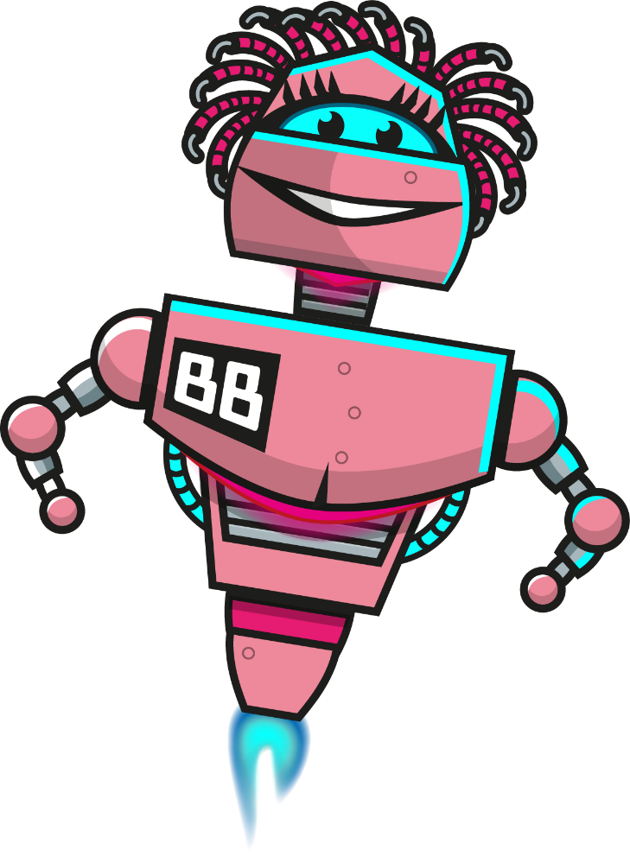
[Menu]
I’m BettyBot.
Remember my friends?
I’m KittyBot.
I’m NinjaBot.
Notes:
Before revealing each name you could get them to call out the name together.
e.g. “After 3, what’s the name of this bot [pointing to Betty]? 1…2…3…”

Slide 6
[Menu]
Can you think of other words for ‘upgrade’?
I’m looking for spare parts to _ _ _ _ _ _ _ myself.
u p g r a d e
Notes:
Improve, make better, use new parts, get shiny, etc

Slide 7
[Menu]
I want to shine inside and out.
What do you think I mean?
Notes:
This is a good one for partner talk.
e.g. “Discuss what you think this means with your partner for 15 seconds.”
Shining inside and out…wanting to have a good personality, to be kind/nice/friendly/good as well as being strong, shiny, clean, working, etc on the outside.

Slide 8
[Menu]
Shall we take a closer look at ?

Slide 9
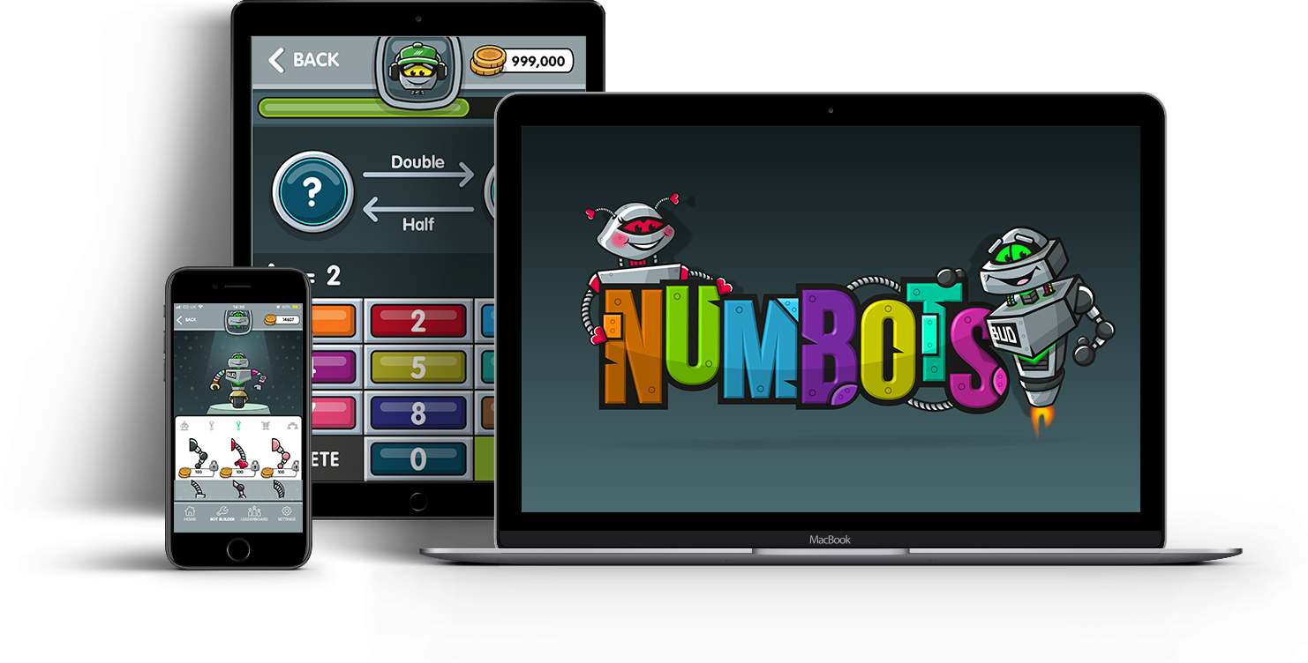
[Menu]
100
Notes:
Available on different devices.

Slide 10
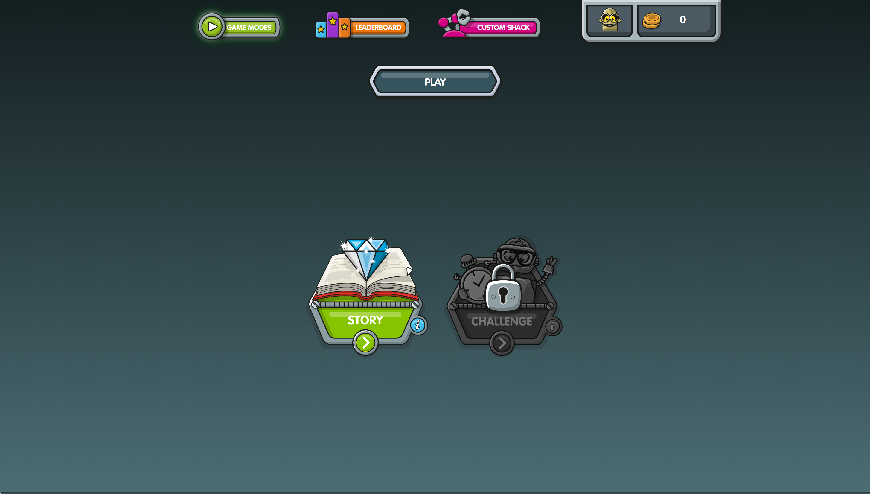
[Menu]
We all begin on Story mode.
Click Story now.
Notes:
There are two game types: Story and Challenge.
When you first play, Challenge is locked so you start in Story mode. To unlock Challenge you need to complete a certain level in Story mode (which is towards the end of the Iron stage).

Slide 11
[Menu]
These are called Stages.
There are 18 Stages.
Next slide
Notes:
There are 18 stages. You start on Rust.
Rust stage contains 5 training levels to familiarise pupils with the interface.

Slide 12
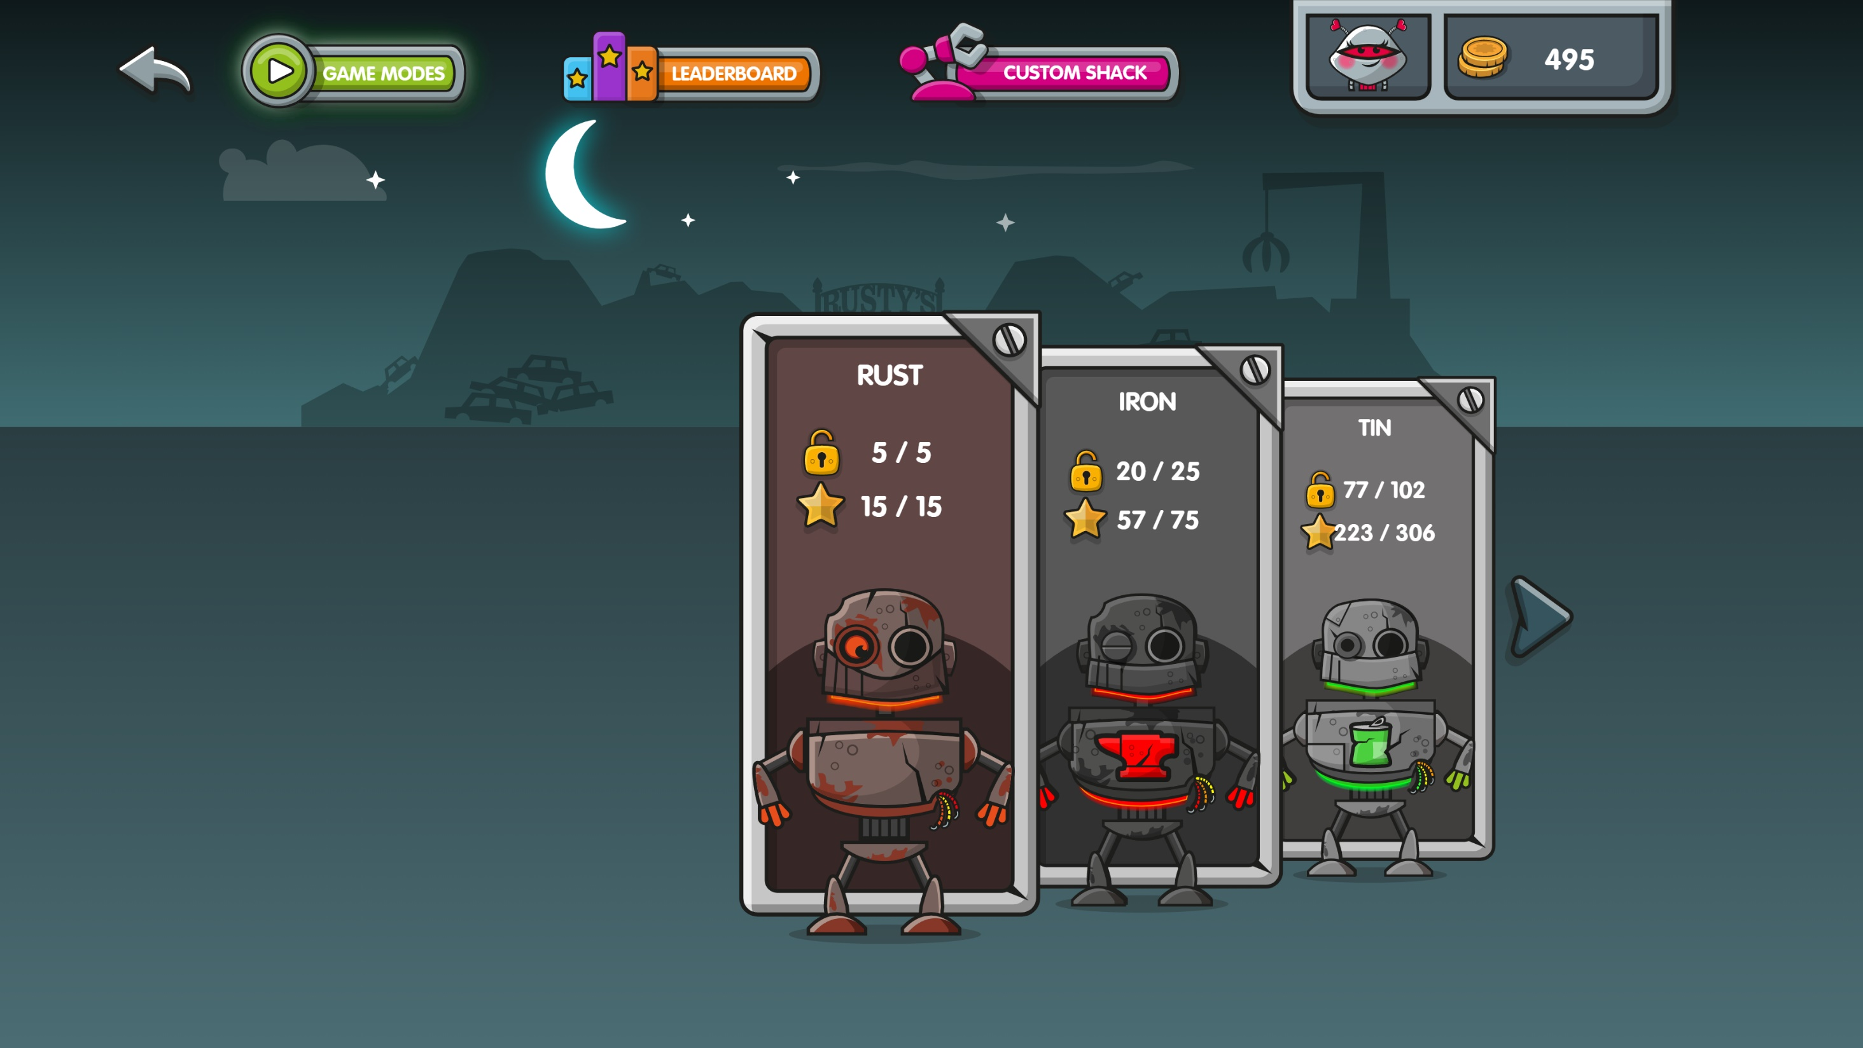
[Menu]
Press on Rust

Slide 13
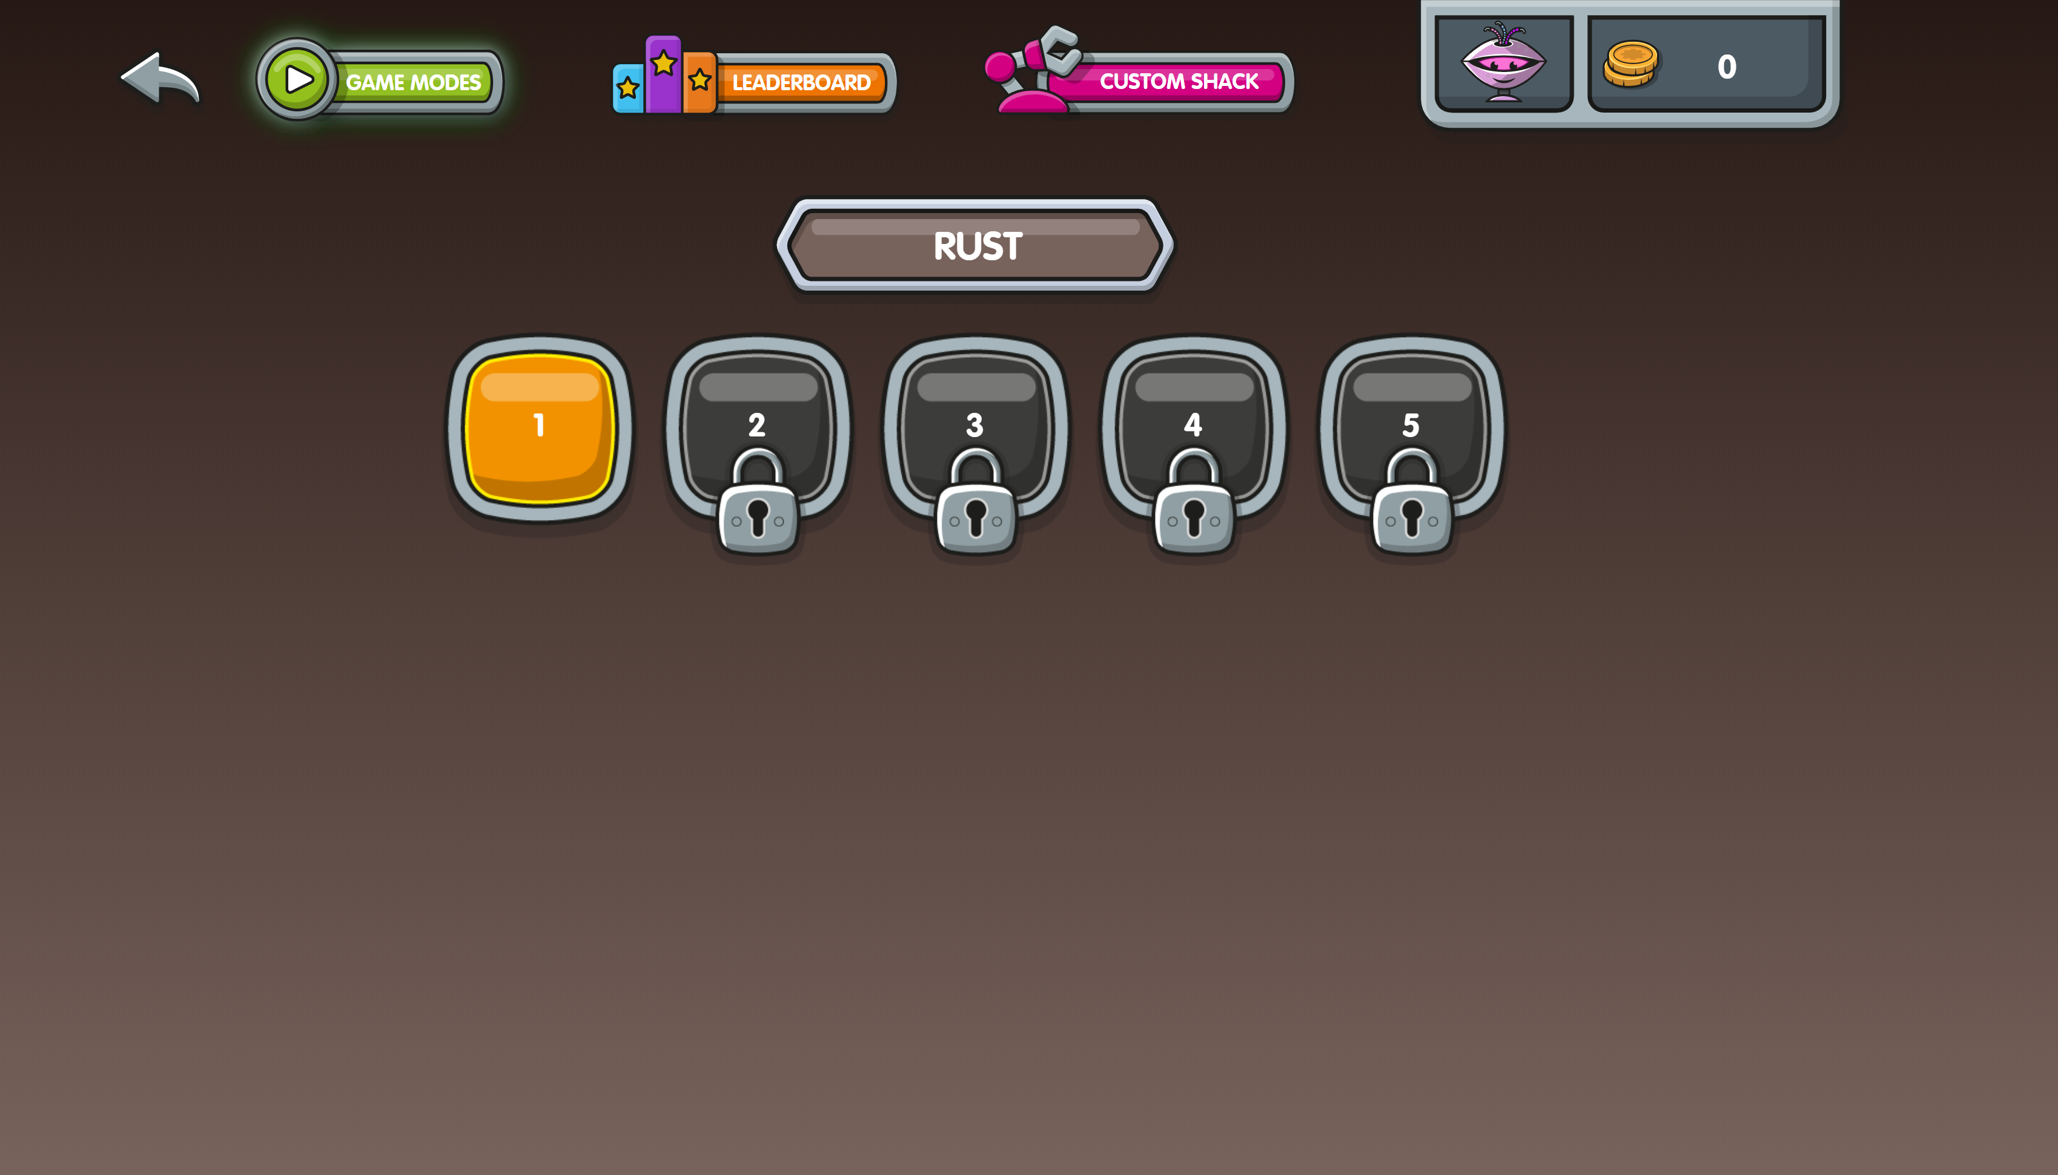
[Menu]
Press Level 1
Notes:
Within each stage there are levels. Start at level 1 and unlock them as you go.
Has anyone played Angry Birds? If so, it’s like that.

Slide 14
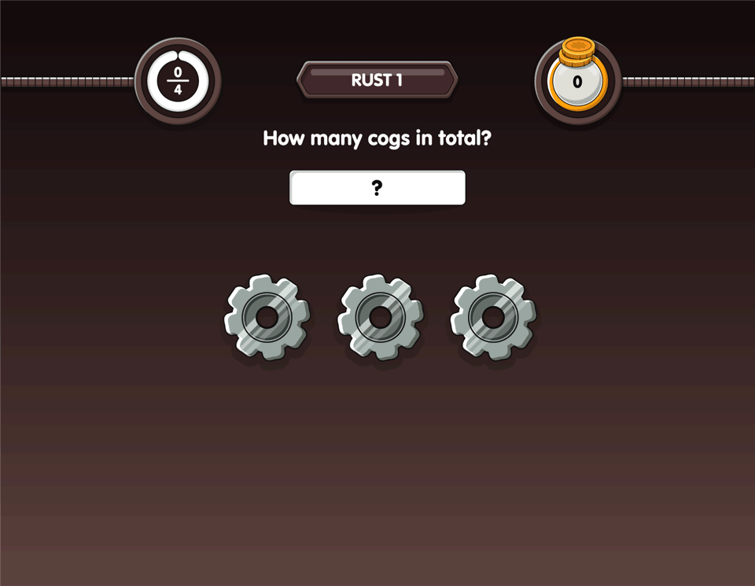
[Menu]
Notes:
The purpose of this animation is to show the pupils that you need to press Enter after each answer.

Slide 15
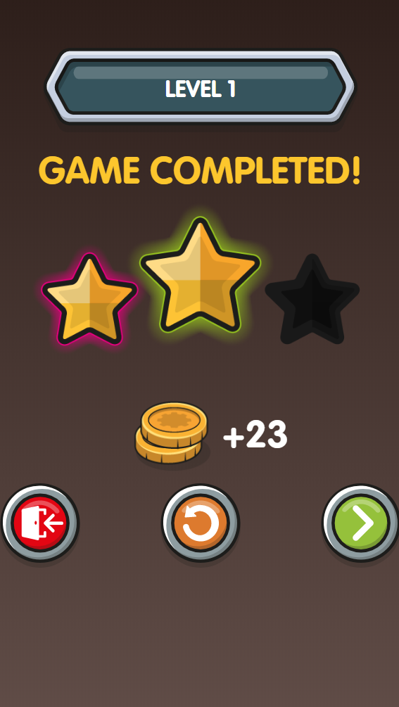
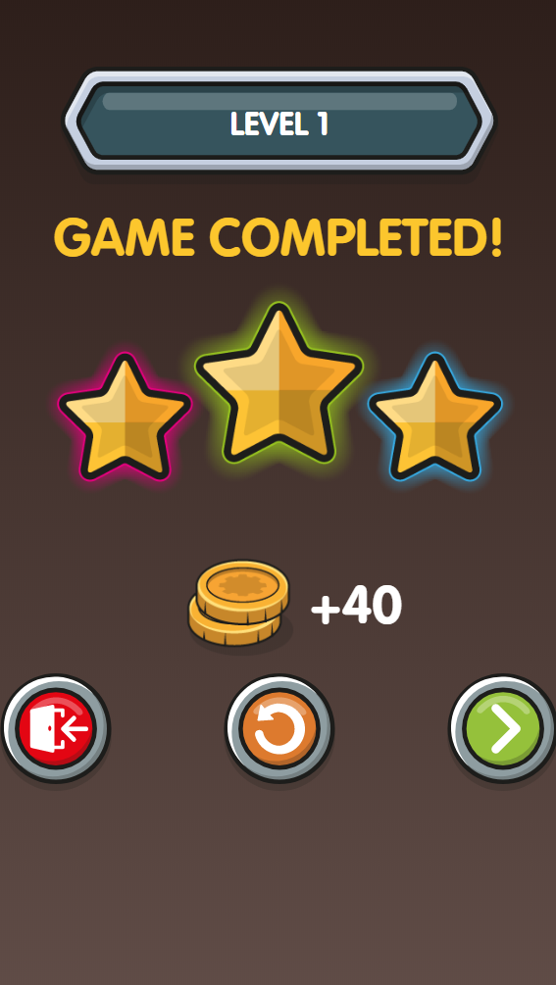
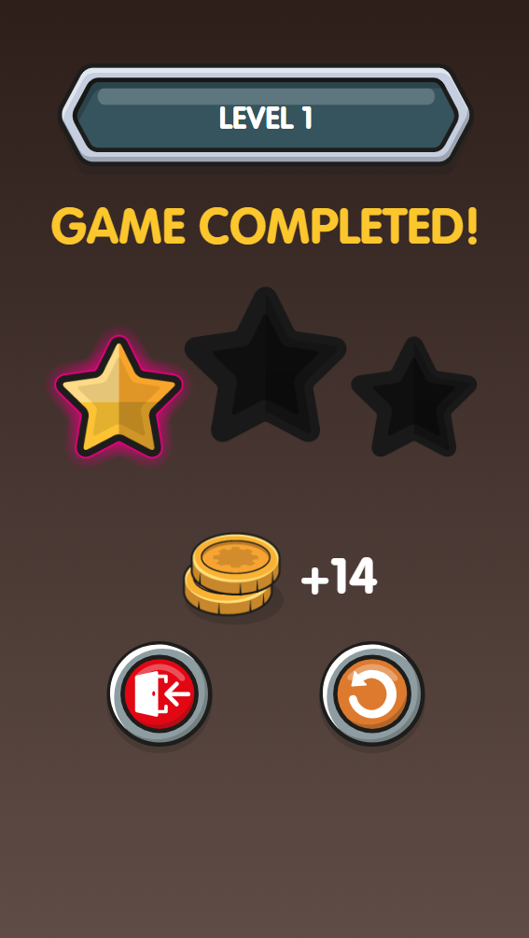
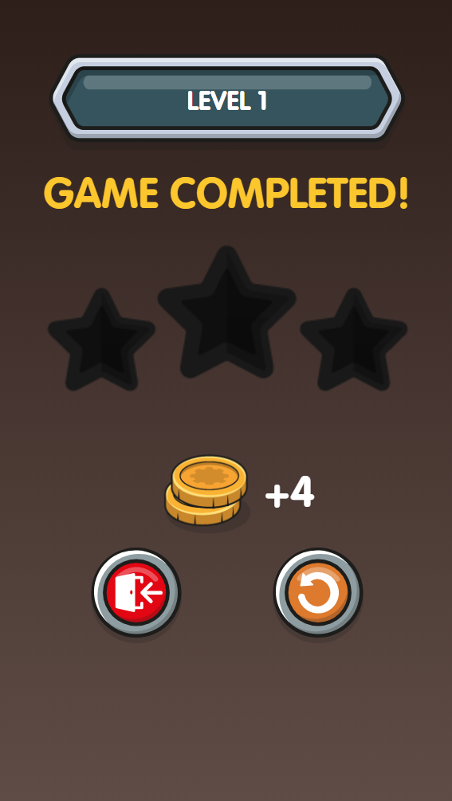
At the end of the level you will see how many stars you earn.
[Menu]
Earn 2 or 3 stars to unlock the level.
Have another go.
Notes:
The orange button means “have another go” or “repeat the level”. You need to earn at least 2 stars to unlock the next level.

Slide 16
[Menu]
What do you think this button does?
And this one?
Notes:
The red button takes you back to the level selection screen.
The orange button restarts the same level.
The green button moves on to the next level.

Slide 17
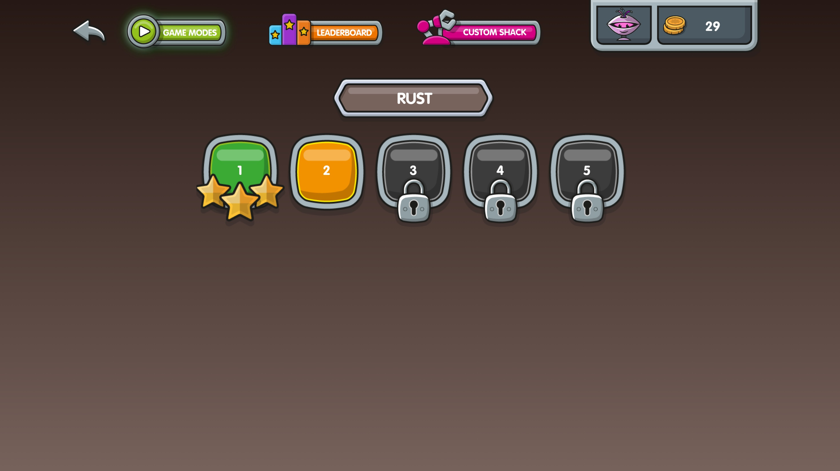
[Menu]
I play level 2.
Why is level 3 not unlocked?
Level 2 is now unlocked.
Notes:
Feel free to skip this slide if you want to save time.
Level 3 is still locked because I only earned 1 star.

Slide 18
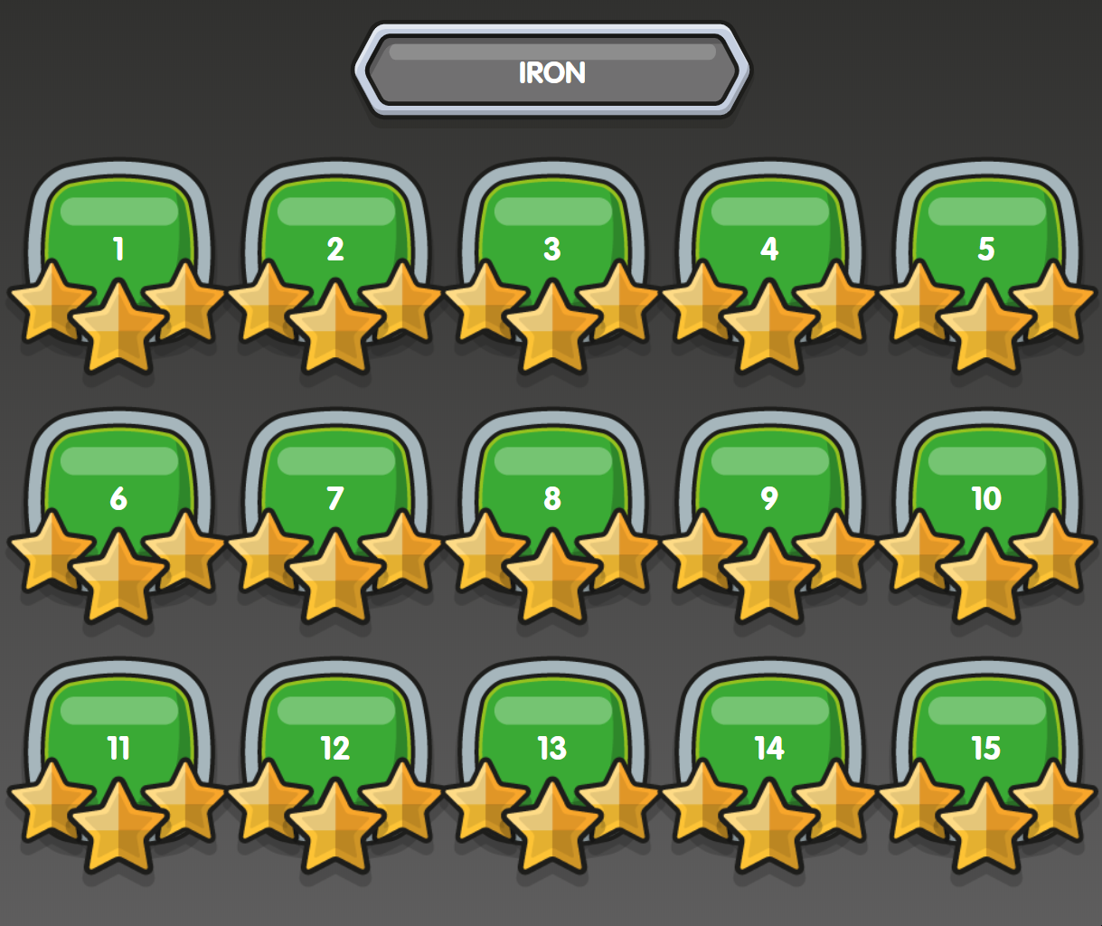
[Menu]
Iron
Notes:
When certain levels are unlocked, the player earns a part to upgrade Rusty.
The parts the children are collecting are evenly distributed throughout the stage.
There are 5 parts to earn in each stage so in stage like Rust, with 30 levels, the parts will be earned every 6 levels.
That might be more detail than you need!
Feel free to skip this slide if you want to save time.

Slide 19
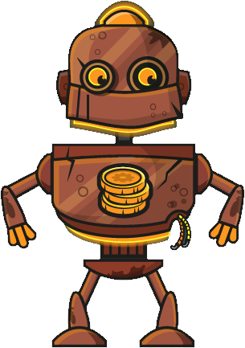
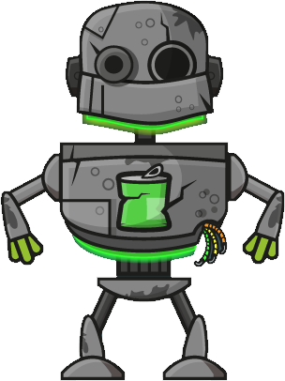
[Menu]
In every Stage, you earn parts to upgrade Rusty.
Iron
Tin
Copper
Notes:
Here are examples of the parts that players unlock in the first three stages.
Feel free to skip this slide if you want to save time.

Slide 20
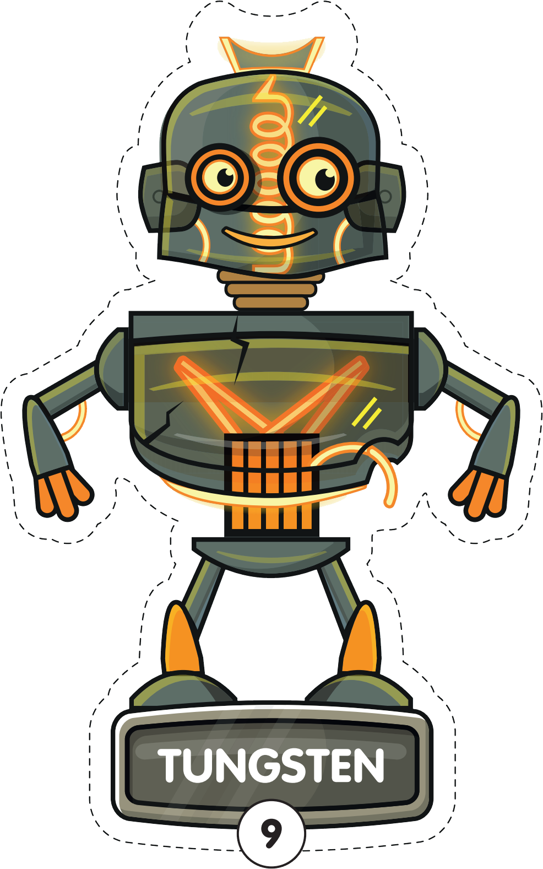
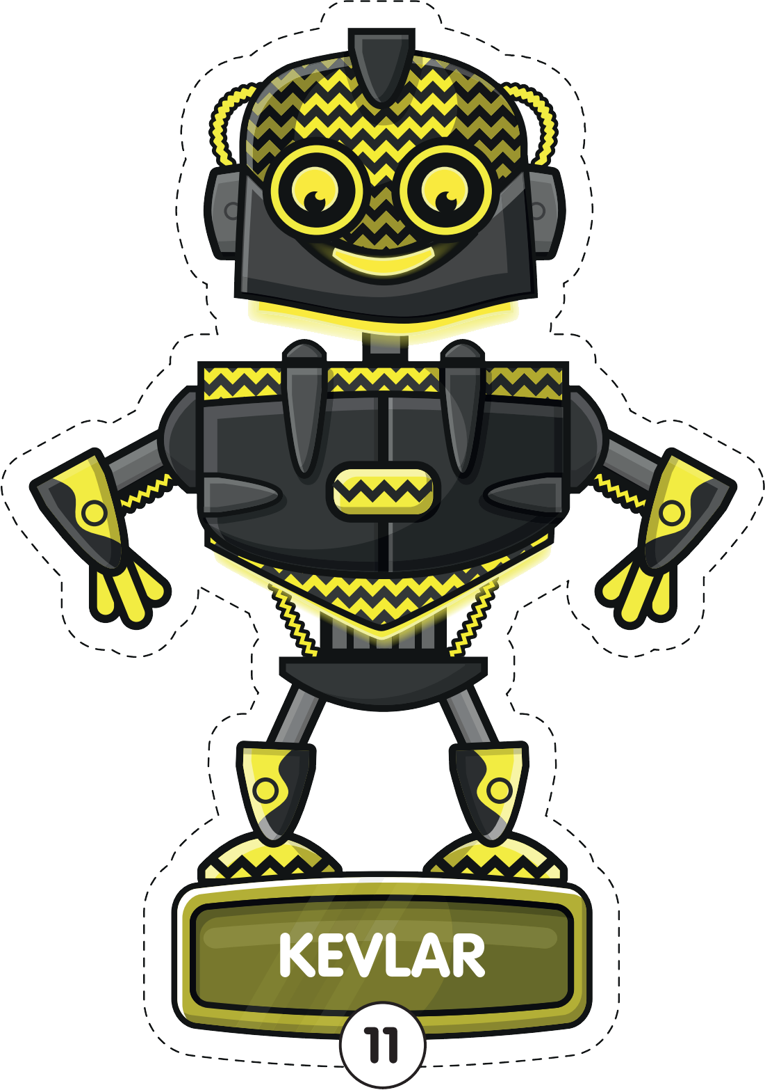
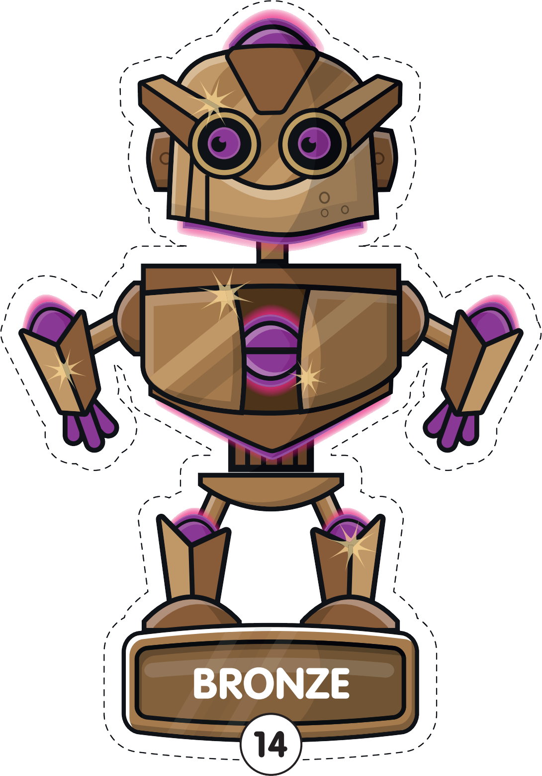
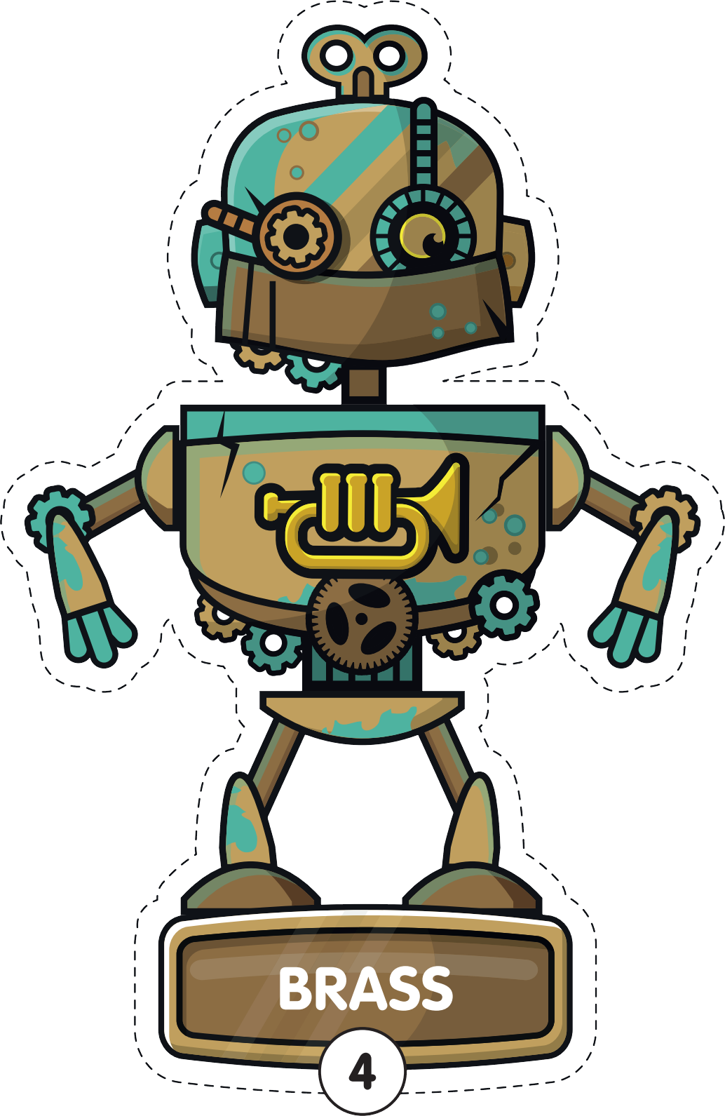
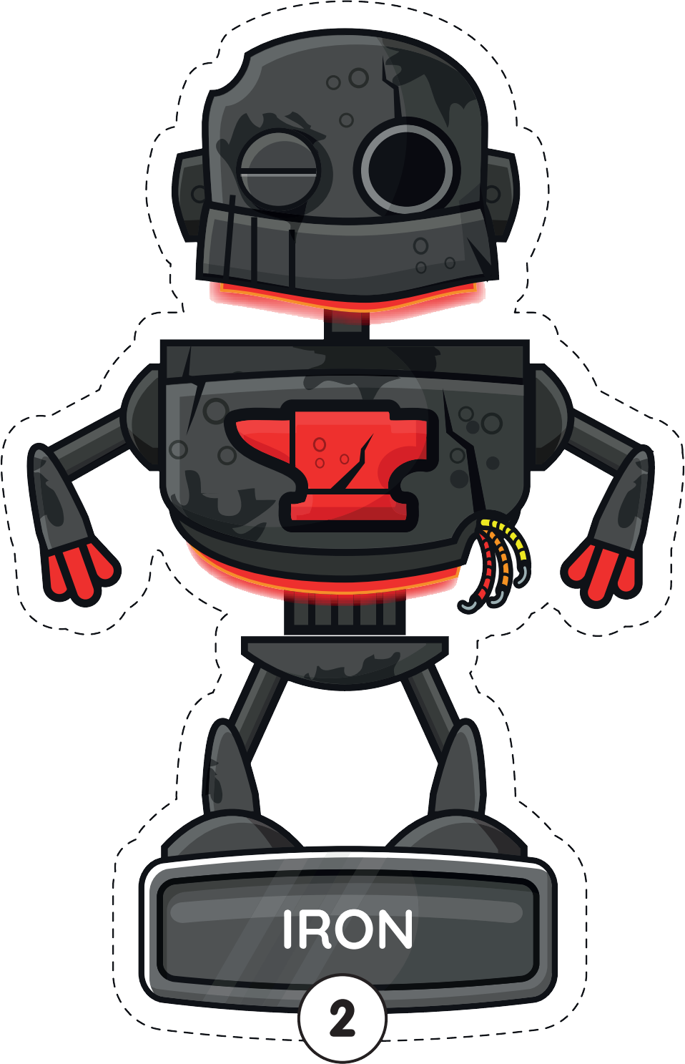
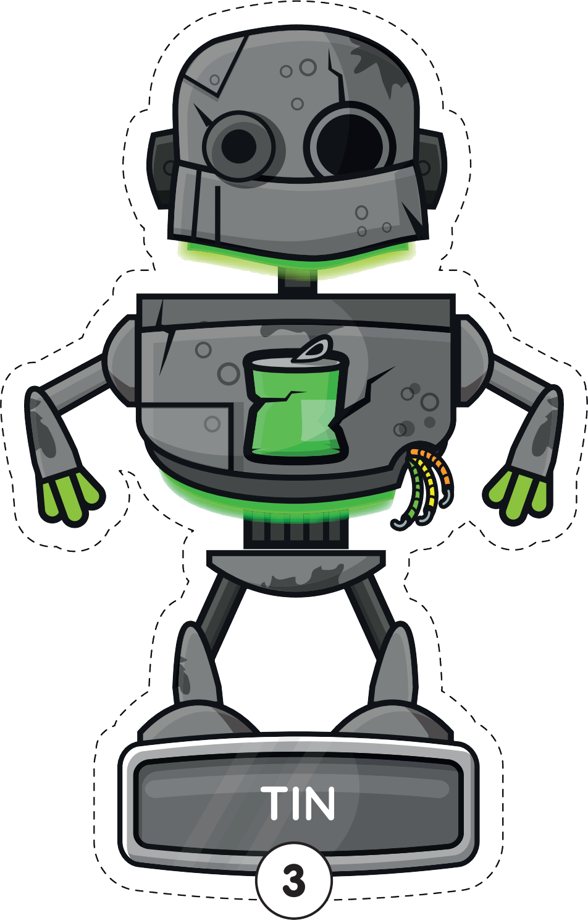
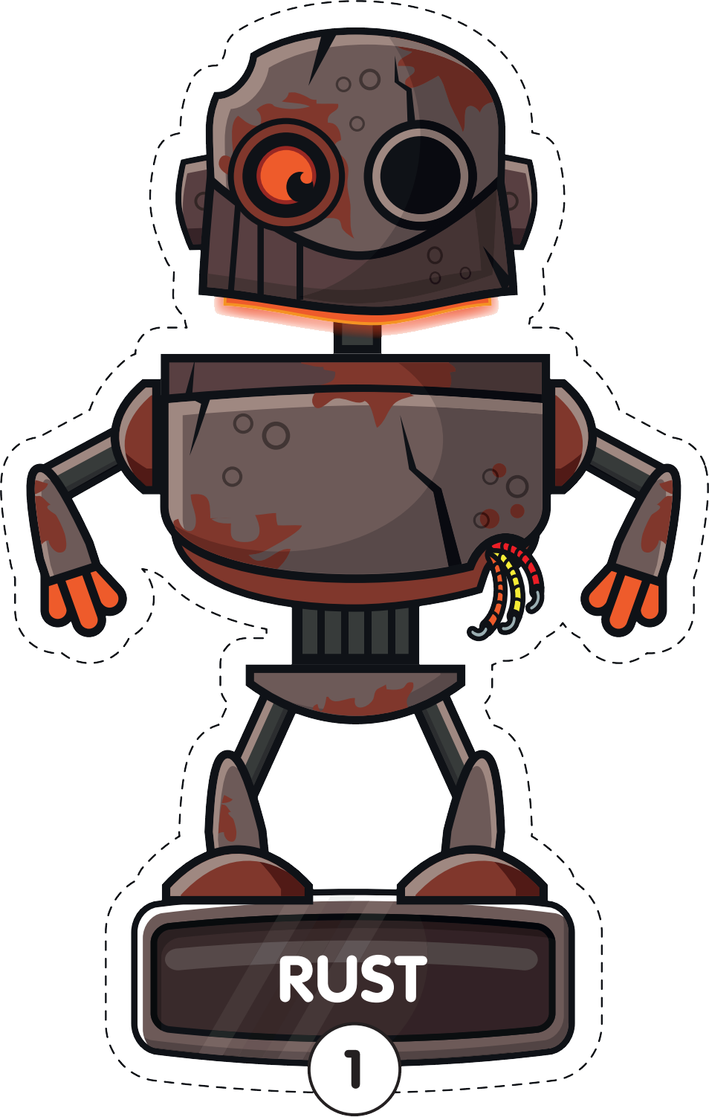
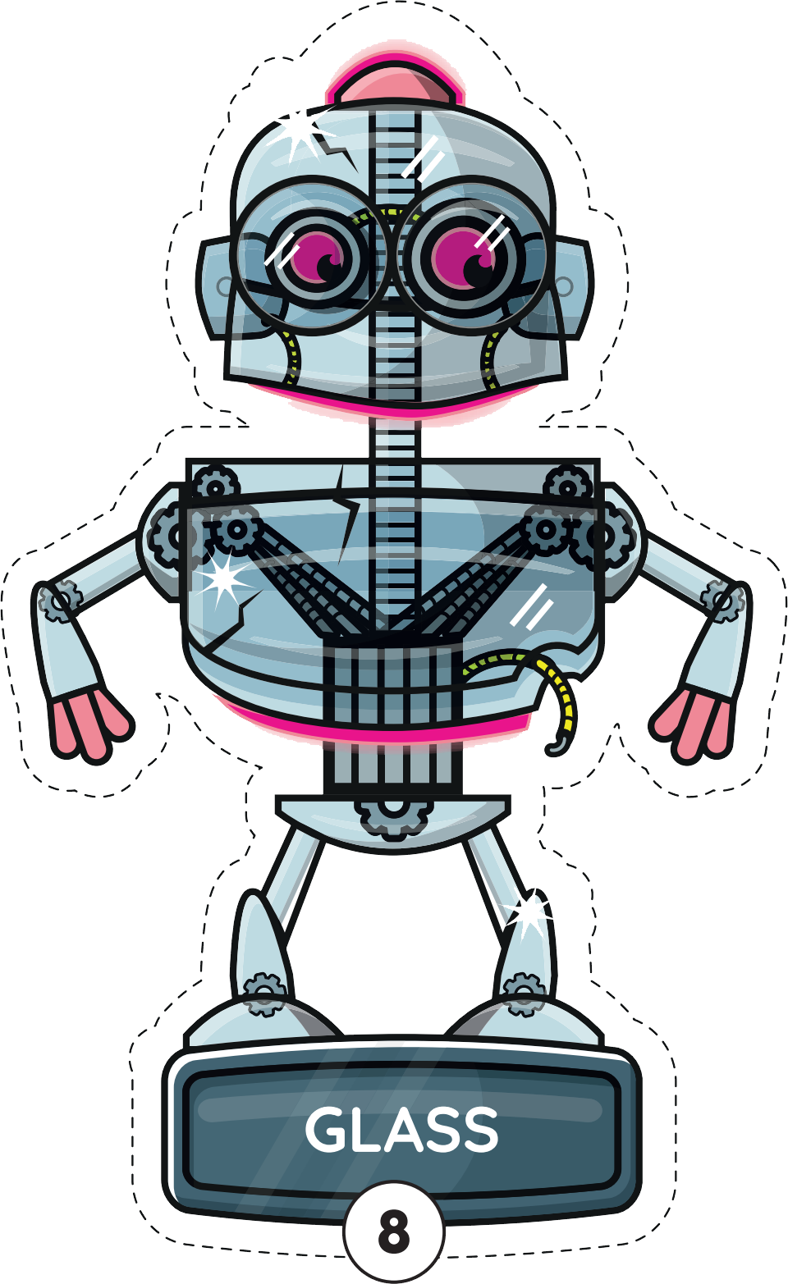
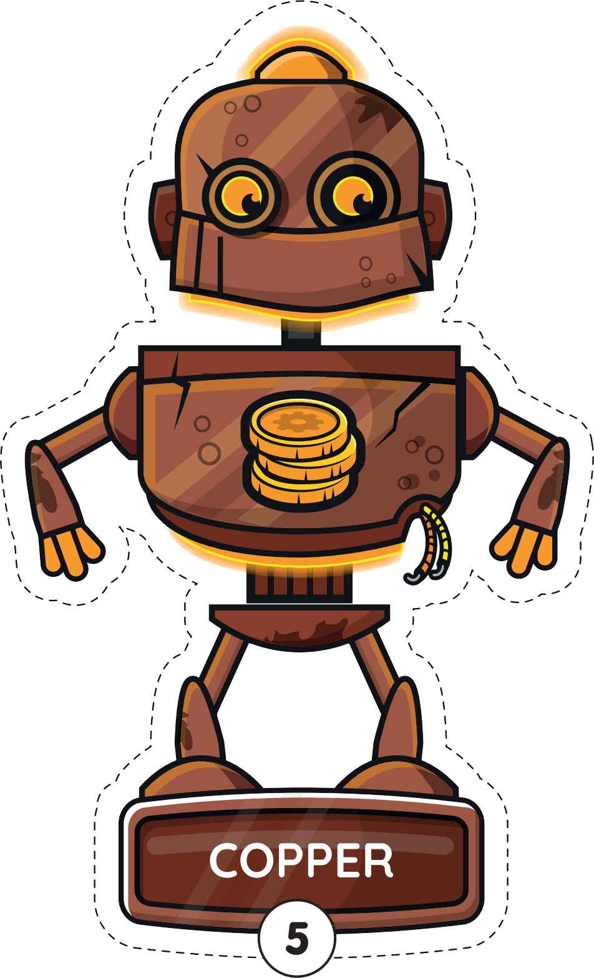
[Menu]
Here is Rusty upgrading at the end of each Stage.
Notes:
The full transformation from Rust to Diamond! Just for fun ☺
Feel free to skip this slide if you want to save time.

Slide 21
[Menu]
At this point, it’s usually a good time to get the pupils logging in.
They need to navigate to play.numbots.com

Slide 22
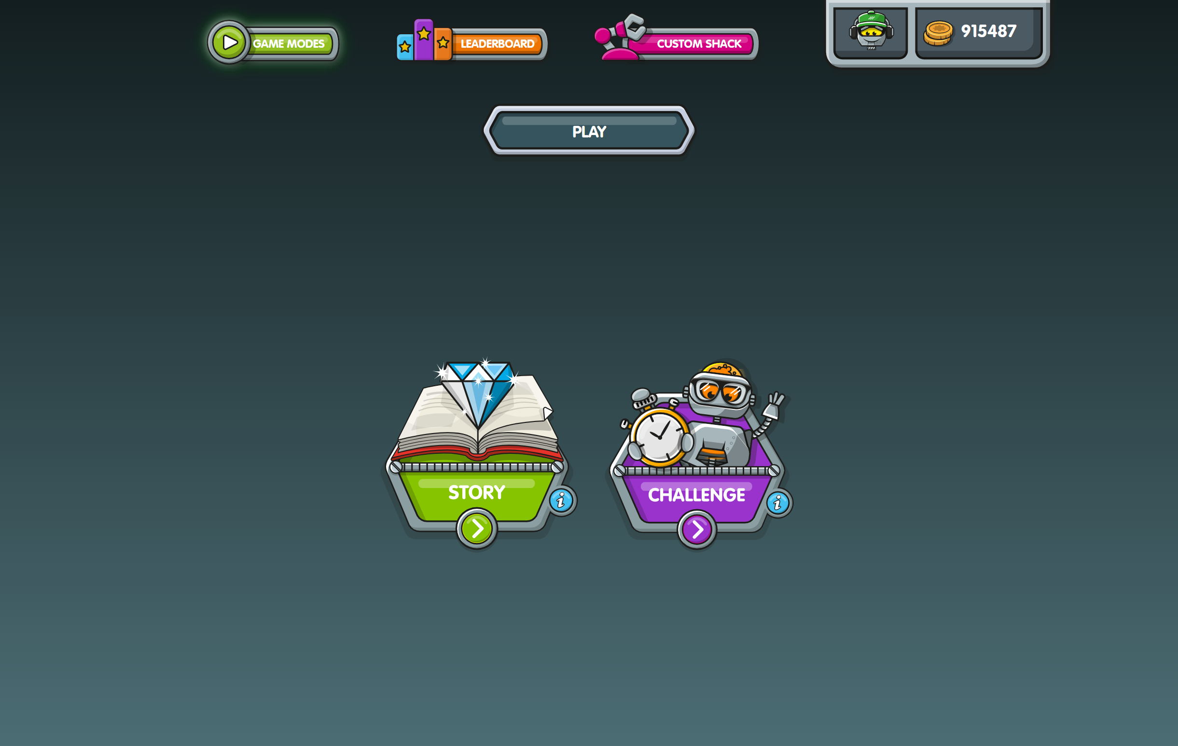
[Menu]
Click on Challenge
Notes:
Challenge mode example. Feel free to skip this slide if you want to save time.

Slide 23
[Menu]
20 levels
Correctly answer as many as you can
Different skills
Correctly answering 12 questions unlocks next level
60 seconds
Notes:
Challenge mode is about speedy correct answers on different skills.
Remember, Challenge mode is locked to start with and can only be unlocked by getting to a certain point in Story mode.
You start in Challenge level 1. To unlock the next level, you need to correctly answer 12 questions in a minute.
Each time you play a Challenge level it lasts 60 seconds. The objective is to correctly answer as many as you can.

Slide 24
[Menu]
Logging In
Notes:
This section is for when the children are in front of a device.

Slide 25
[Menu]
Watch closely so that you know what to do.
Logging In
Notes:
Depending on the age of your pupils, you may need to walk them through everything on the teacher screen first.
However, if they’re IT savvy enough, you could just tell them to login and let them figure it out. It’s not complicated, particularly for those who have logged into TT Rock Stars before.

Slide 26
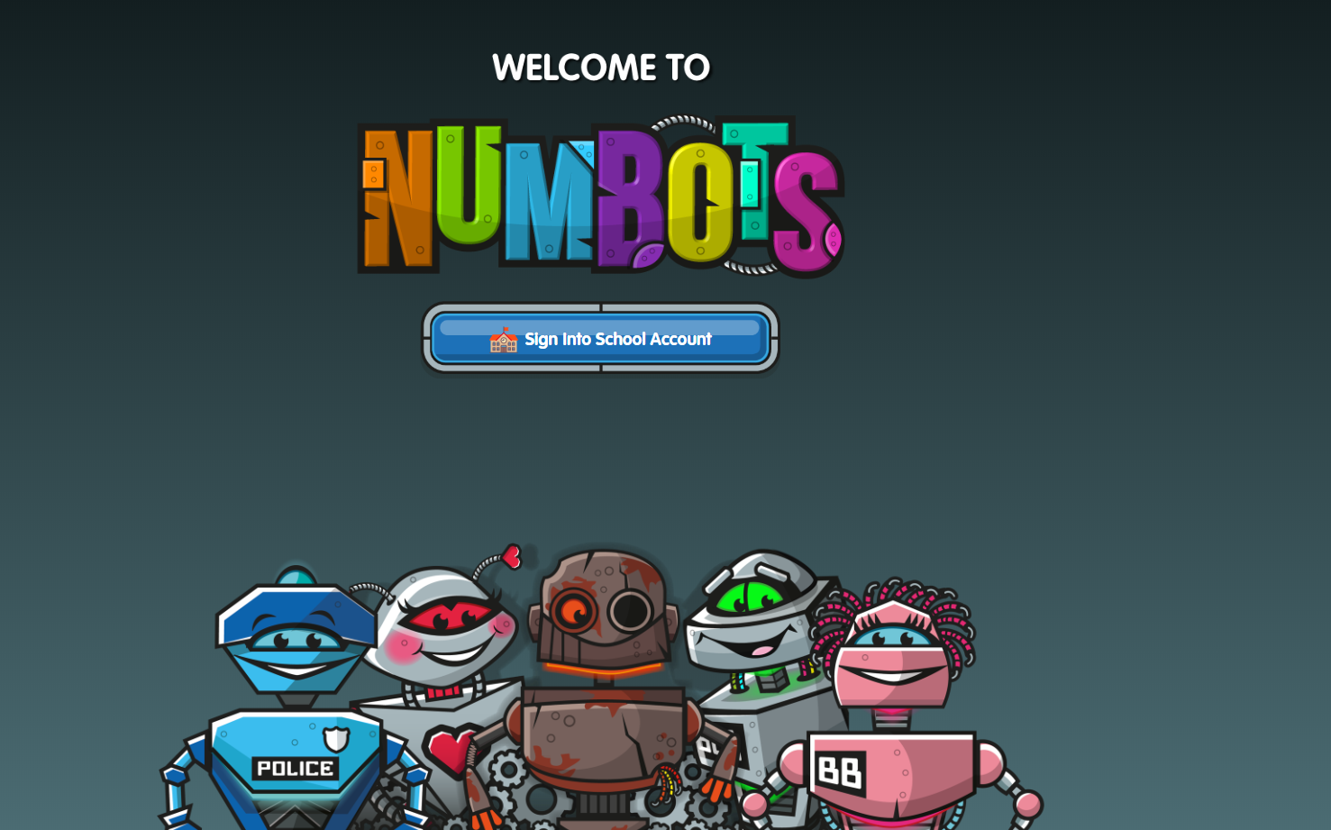
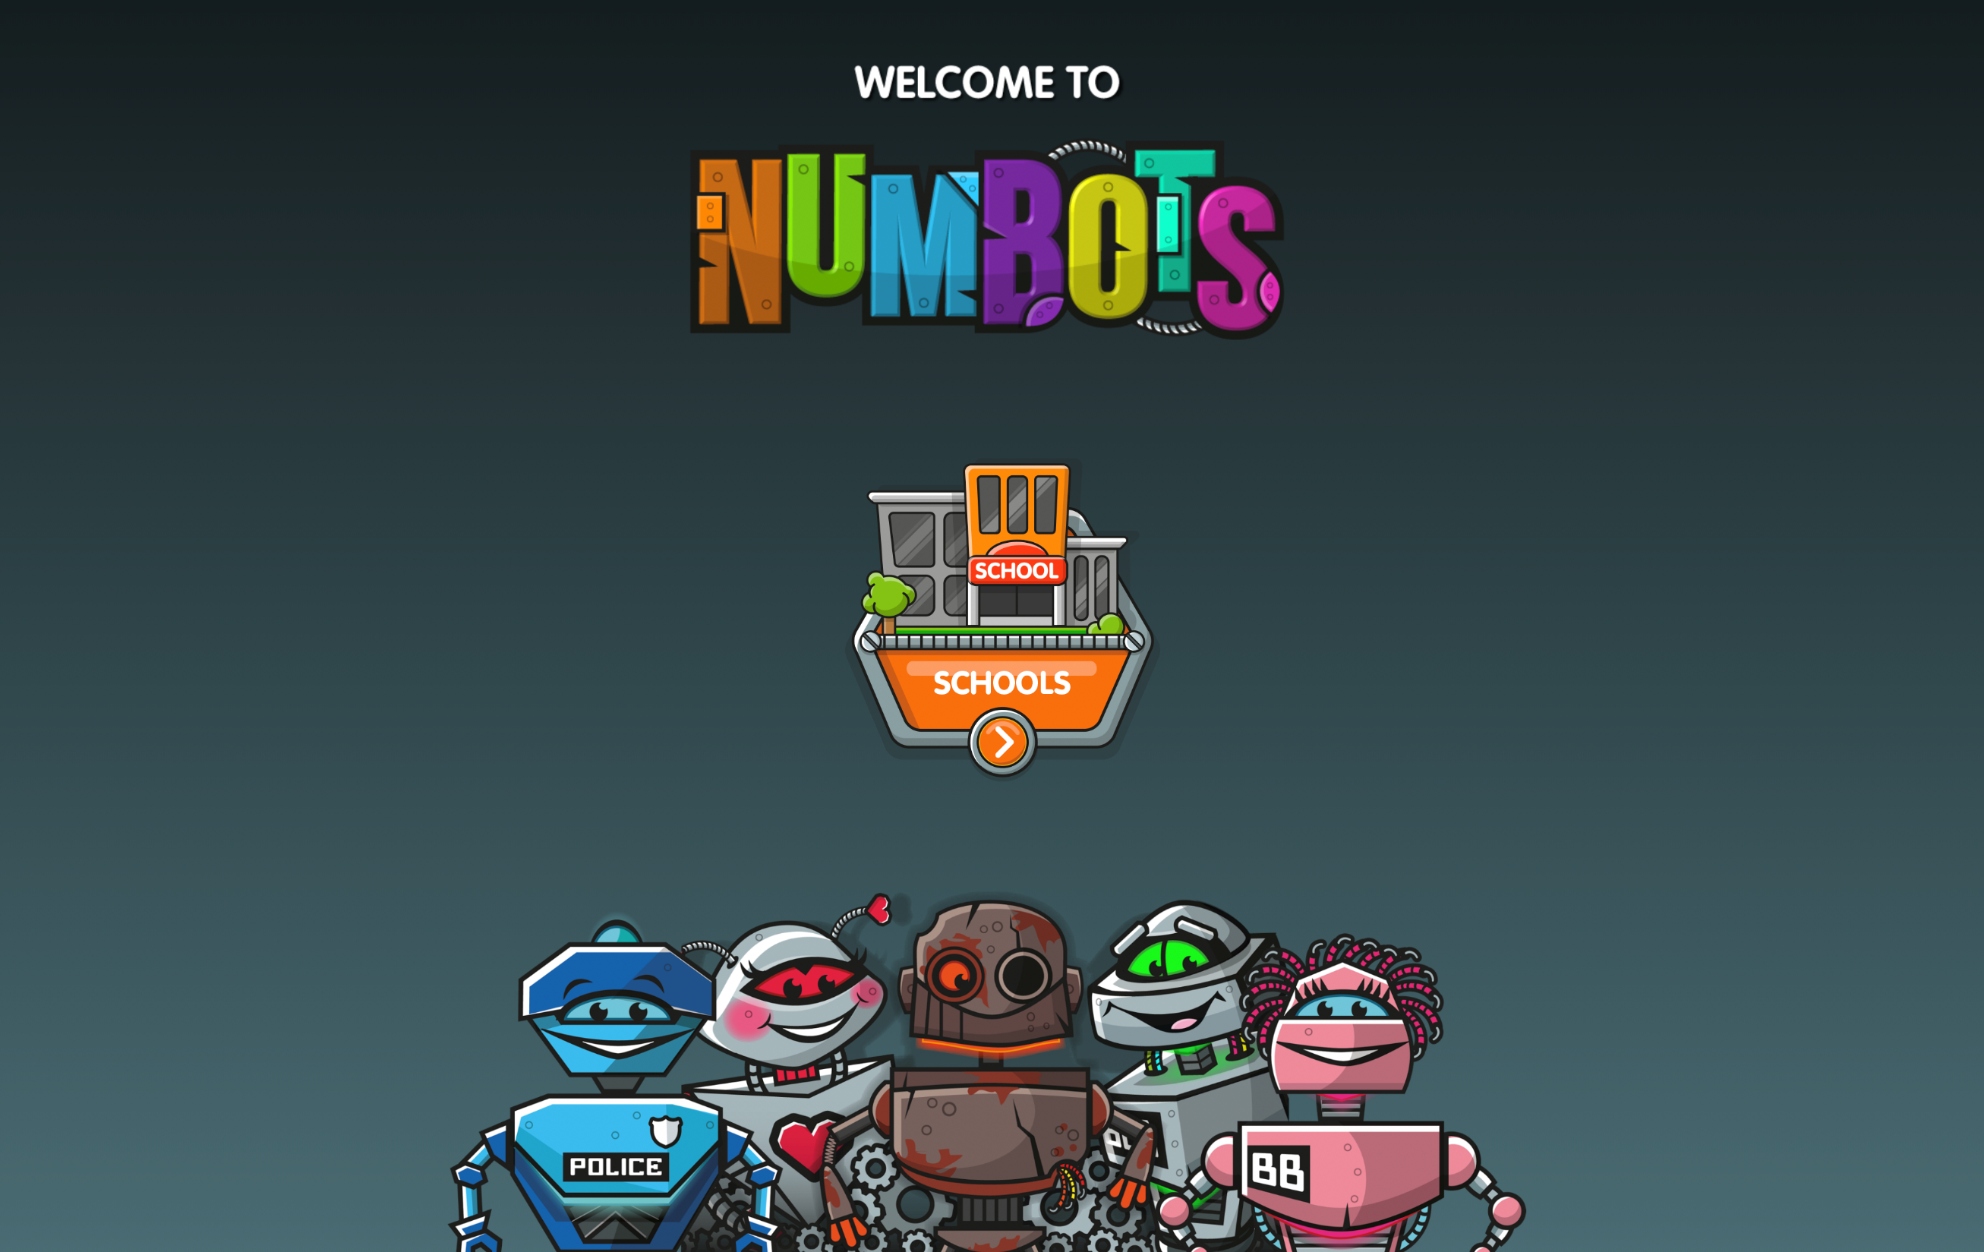
[Menu]
100

Slide 27
[Menu]

Slide 28
[Menu]
Type school name or postcode

Slide 29
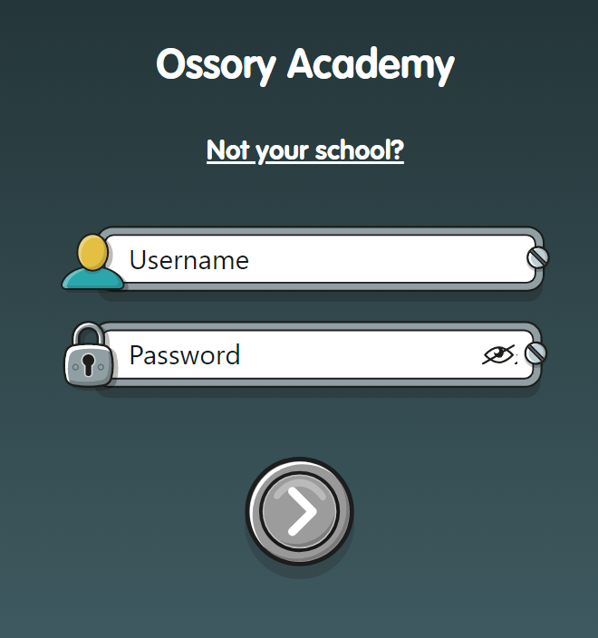
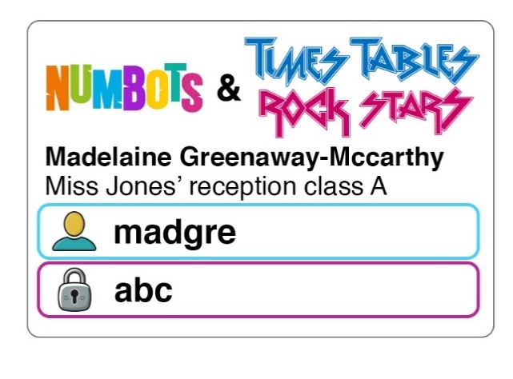
[Menu]
Example label
Logging In
madgre
abc
Your turn!

Slide 30
[Menu]
PO21 3LW

Slide 31
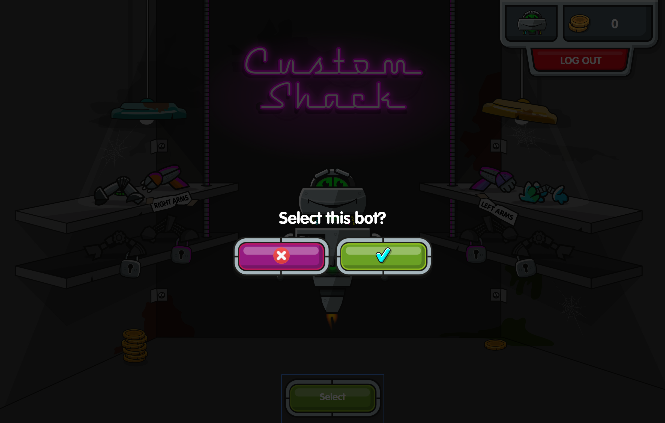
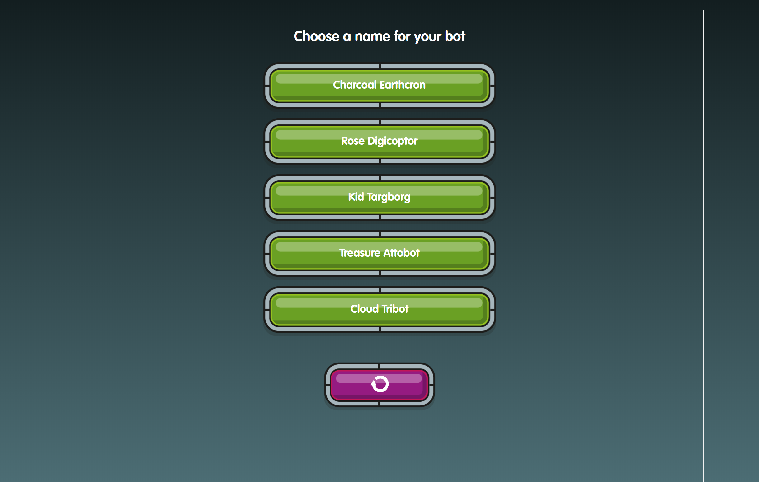
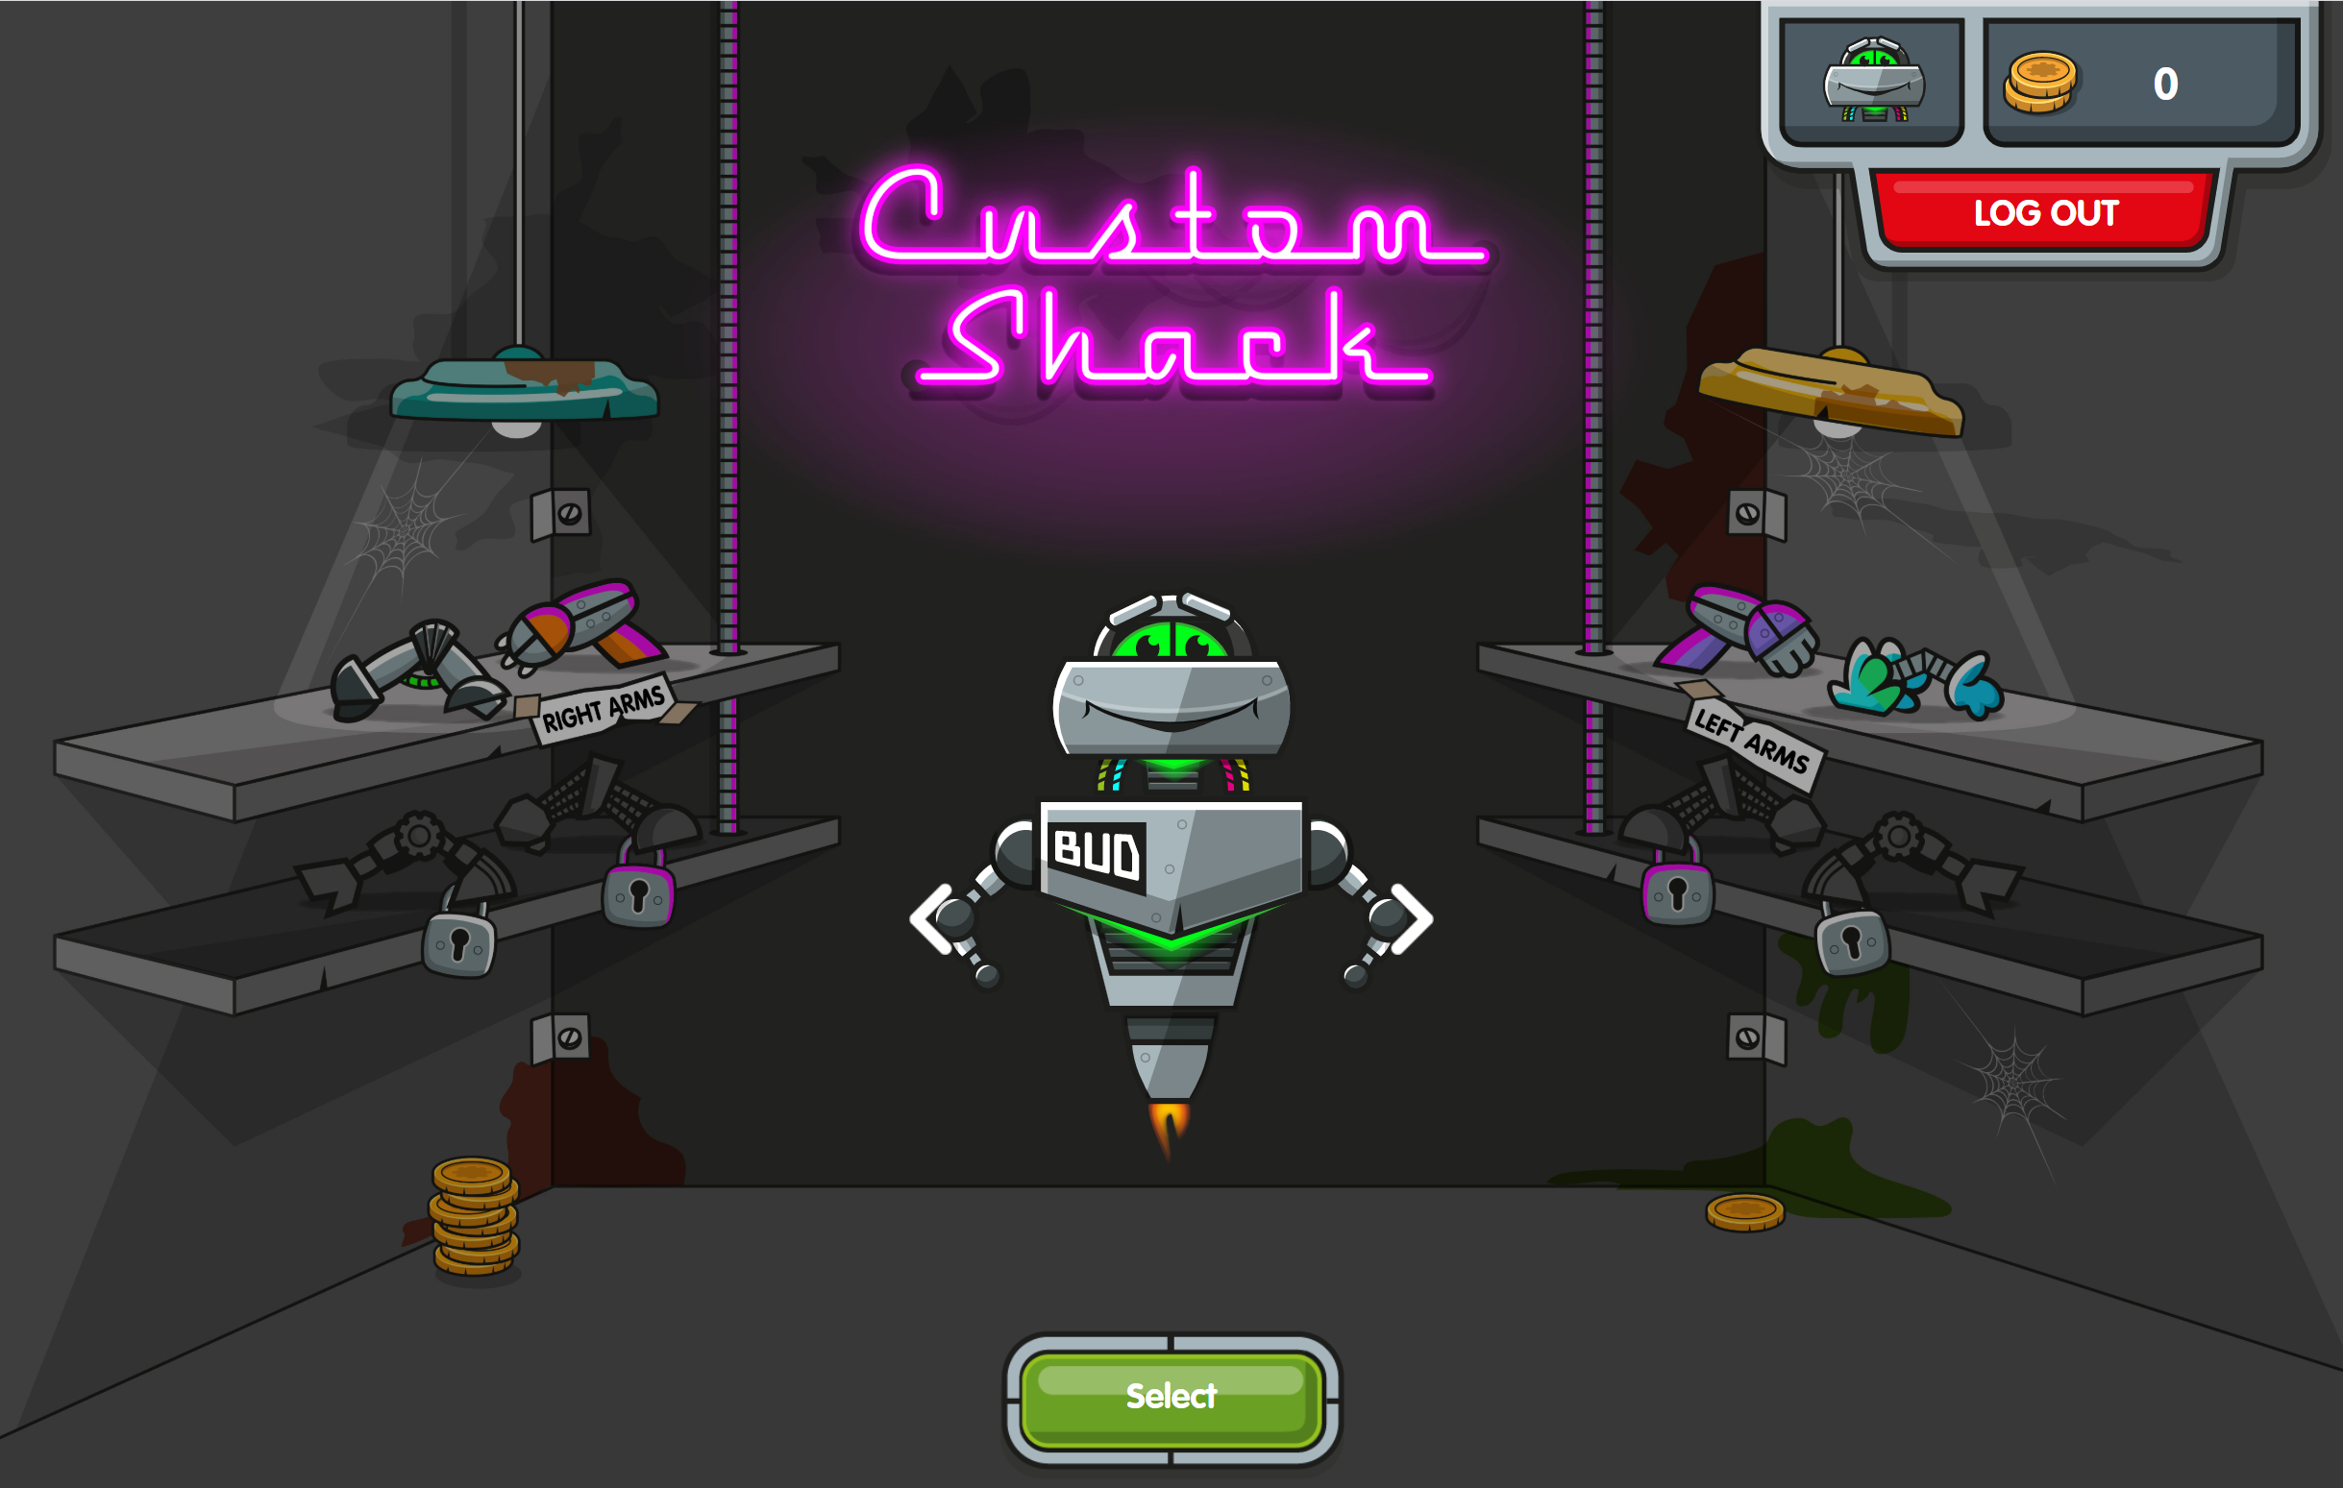
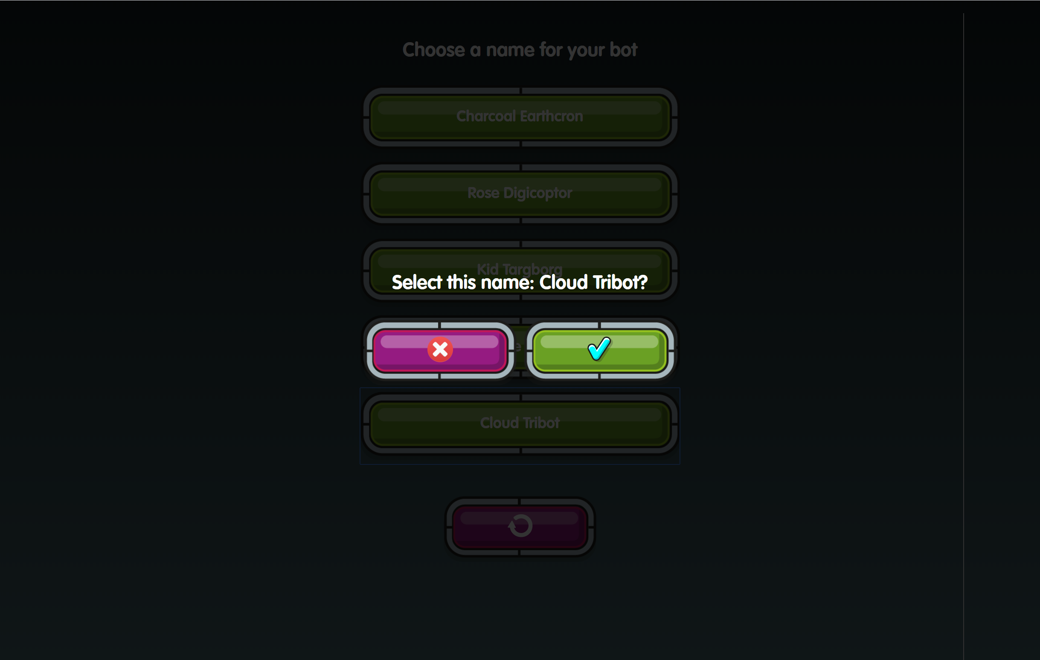
Step 1
Step 2
[Menu]
Choose your Bot!
There are 3 to choose from.
Choose a name for your bot!
Notes:
Log in with your username and password and choose your Bot. Once you have chosen your Bot you cannot go back and change them BUT you can customise once you have earned some coins to spend at the custom shack!

Slide 32
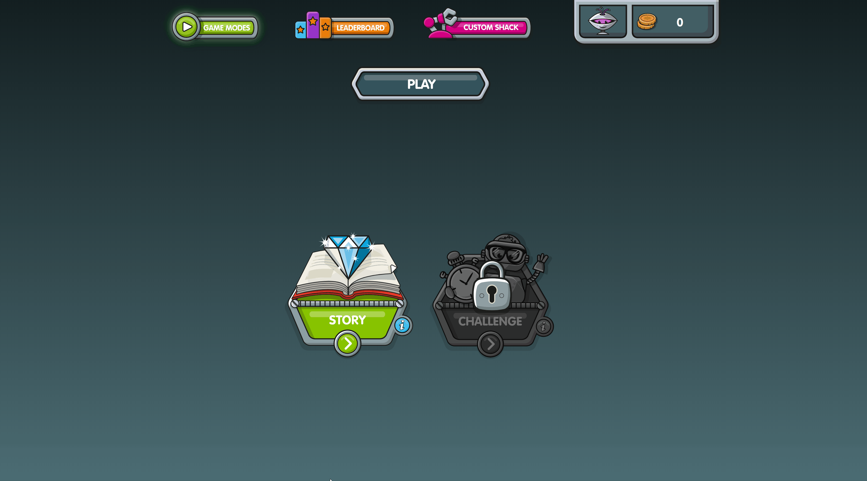
[Menu]
Step 3
Click on Story to begin!
Notes:
Click on Story (or “the green button” if your pupils may struggle to read) then Rust, then level 1.

Slide 33
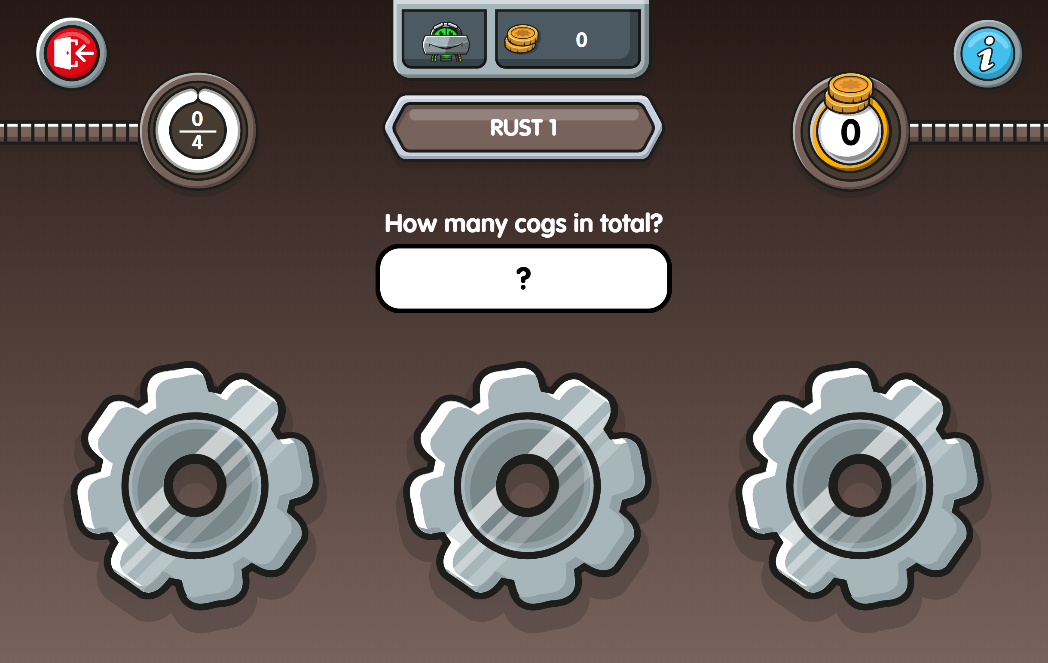
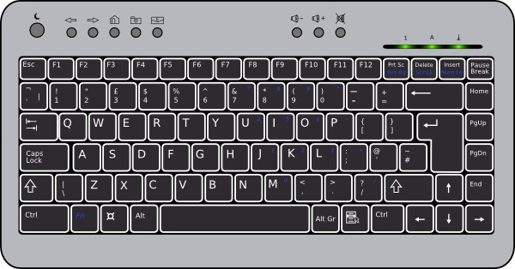
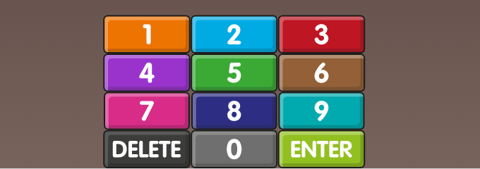
Remember to press ENTER after you type your answer.
[Menu]
Computer
Tablet or mobile
Notes:
Playing Story mode.
Feel free to skip this to save time and get the children playing!
After entering their answer, plays must press the Enter key on the keyboard or onscreen numpad.
The bar flashes green for a correct answer and red bar for an incorrect one.

Slide 34
[Menu]
How did we get on?
How did we get on?
Notes:
Towards the end of the session.
Did anyone unlock the Custom Shack? Earn a badge? Earn an upgrade for Rusty? Change their bot in the Custom Shack?

Slide 35
[Menu]
What are we learning?
Notes:
Feel free to skip this whole section if it’s not right for your audience.
It’s usually best to cover this once they’ve logged in and played on NumBots.

Slide 36
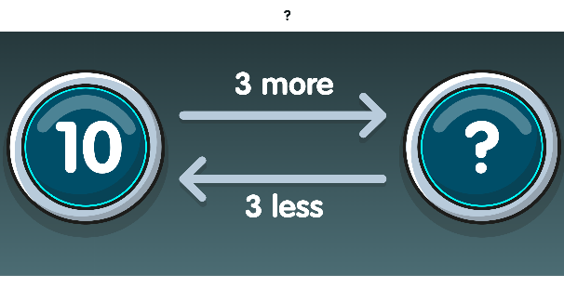
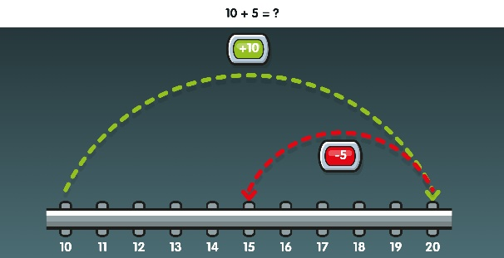
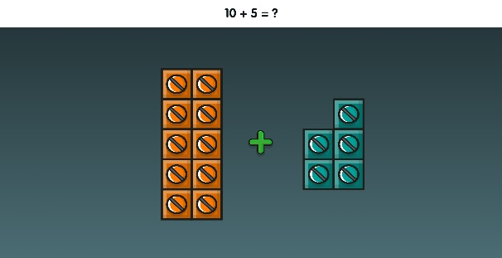
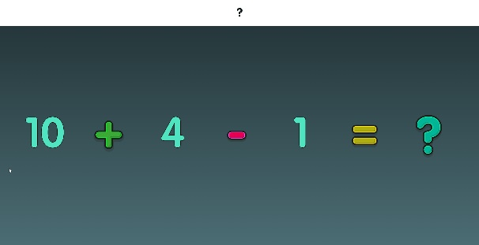
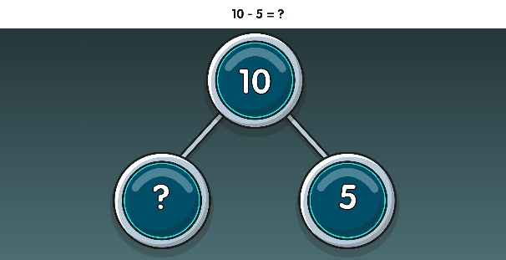
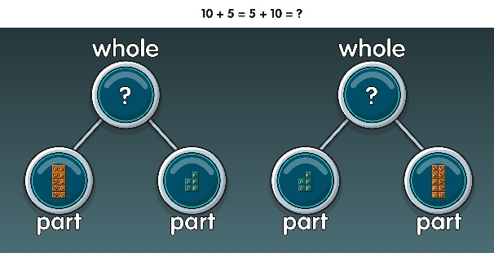
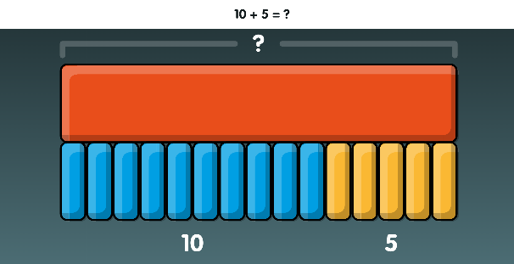
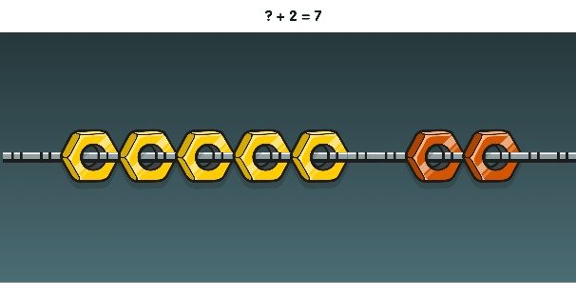
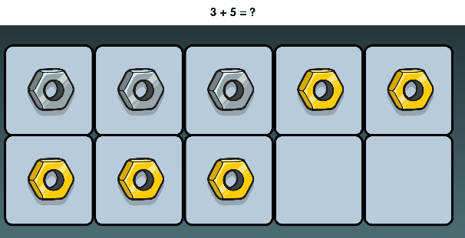
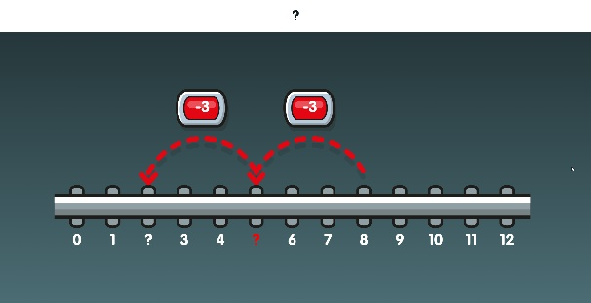
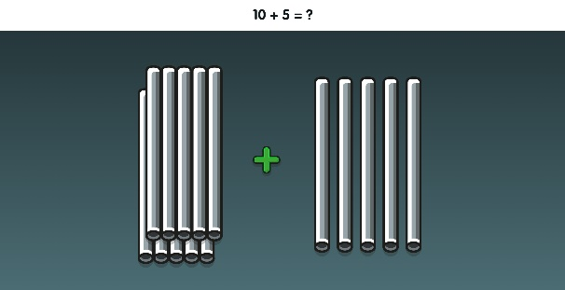
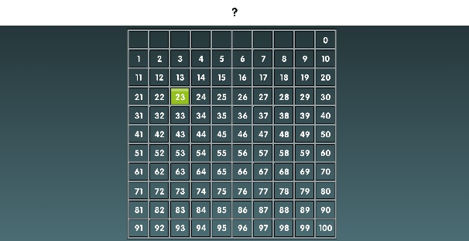
[Menu]
ADDING & SUBTRACTING
Learning Intentions
NUMBER BONDS
COUNTING
100
Notes:
The three core strands of NumBots are subitising (“counting without counting”), number bonds and addition & subtraction.
Here are some screenshots of the representations we use.

Slide 37
[Menu]
Why are we learning these things?
Learning Intentions
Notes:
Feel free to skip this slide if you want to save time.

Slide 38
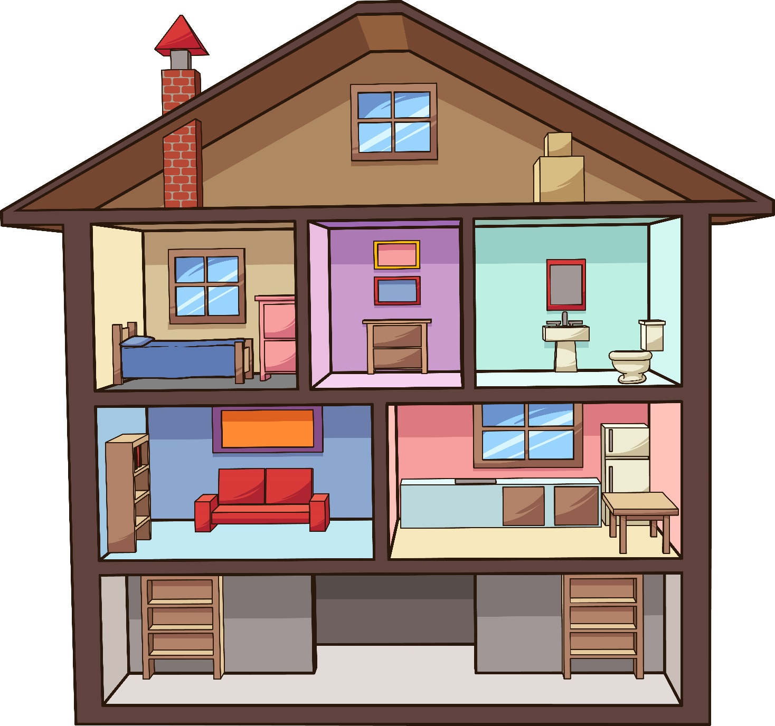
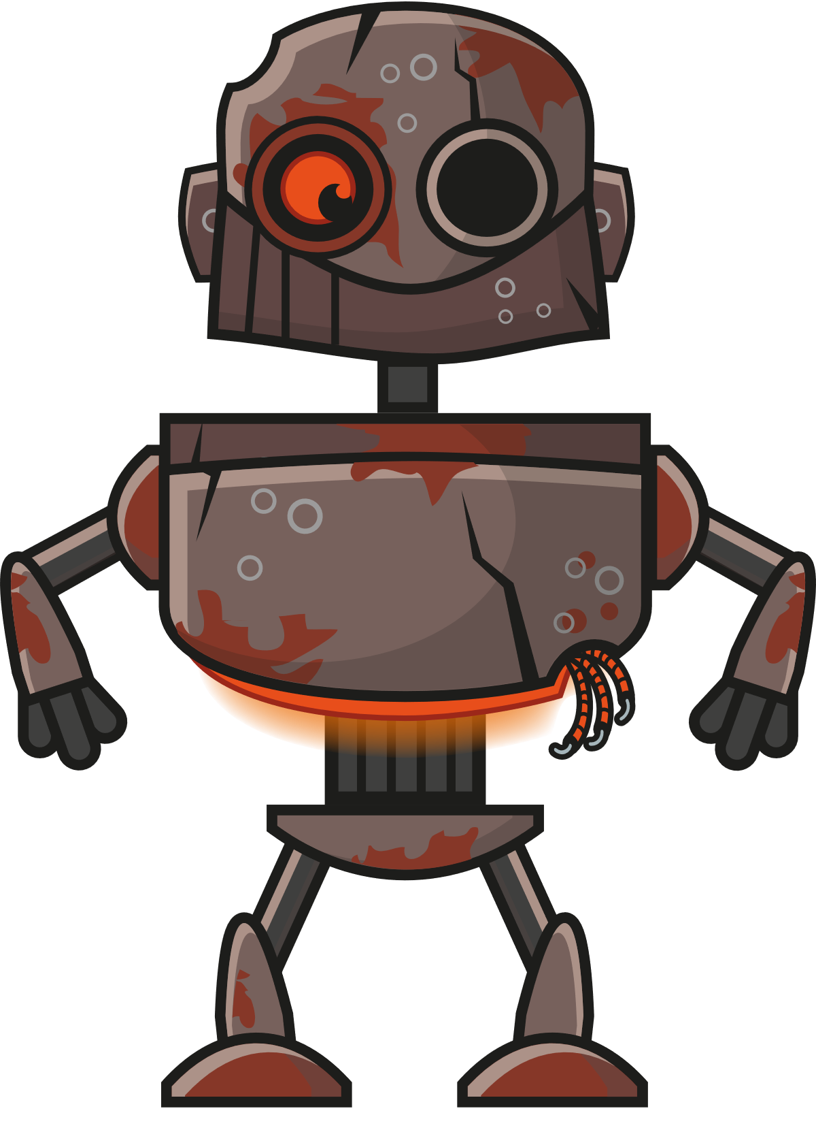
[Menu]
Imagine maths was a house.
You start with counting
and then number bonds.
Those are the foundations.
We can keep building higher
if you have strong walls and floors.
Next, is adding and subtracting.
Then the even more fun stuff!
Learning Intentions
Even more fun stuff!
Adding & subtracting
Number bonds
Counting
100
Notes:
Feel free to skip this slide if you want to save time.

Slide 39
[Menu]
Rewards

Slide 40
Certificates
[Menu]
100
Notes:
Look at all these awesome certificates you can earn!

Slide 41
Badges
[Menu]
100
Notes:
These are earned for completing certain milestones in the game.

Slide 42
Rewards- the Custom Shack!
[Menu]
100
Notes:
When you earn 800 coins, the Custom Shack will unlock. You can spend the coins you’ve earned to customise your Bot.

Slide 43
[Menu]
Wahoo! Addition and subtraction solved!

Slide 44
[Menu]
Helping you and Rusty to shine like a diamond!

